Slide 1
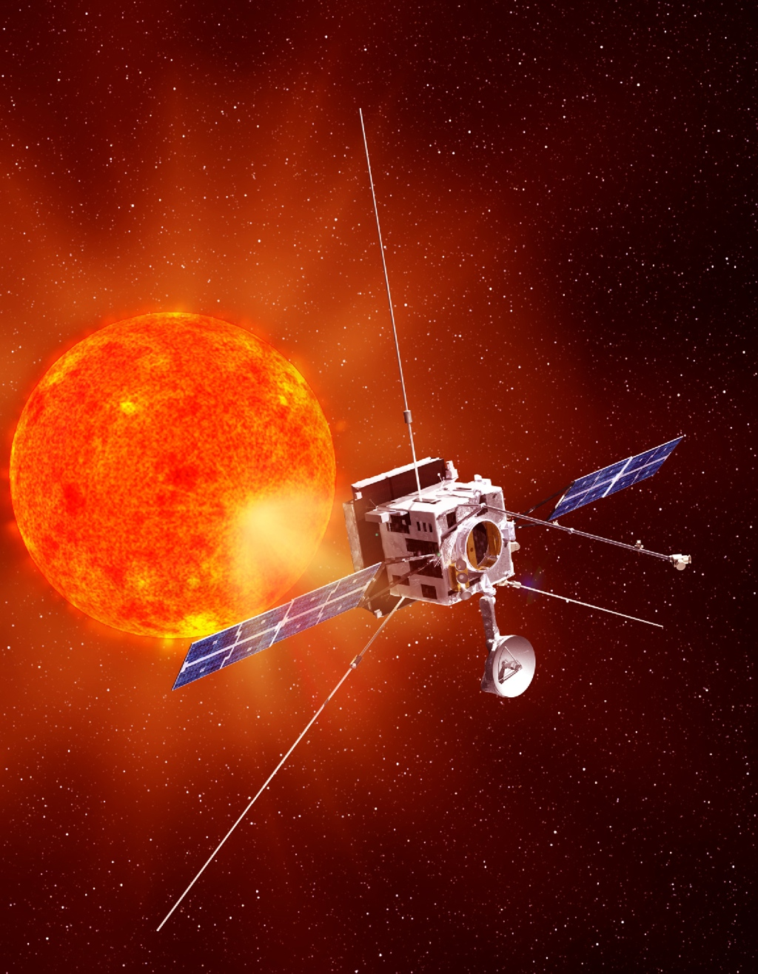
HELIOS mini- Worksop, Köln, June 2016
Solar Orbiter
Exploring the Sun-Heliosphere Connection
Milan Maksimovic
CNRS & LESIA
Observatoire de Paris France

Slide 2
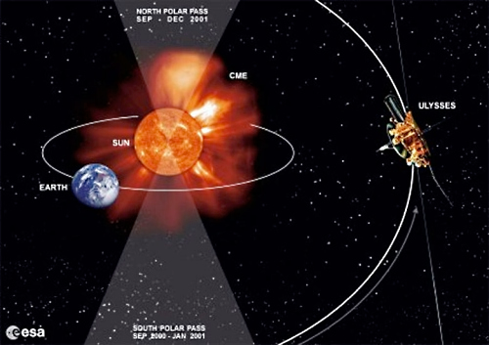
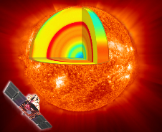
Solar Orbiter
Exploring the Sun-Heliosphere Connection
Solar Orbiter
First medium-class mission of ESA’s Cosmic Vision 2015-2025 programme, implemented jointly with NASA. Launch date : Oct 2018
Dedicated payload of 10 remote-sensing and in-situ instruments measuring from the photosphere into the solar wind
Ulysses
Talk Outline
Science Objectives and Mission Overview
Spacecraft & Payload
Science Synergies
Brief description of the RPW instrument
SOHO
Solar Orbiter

Slide 3
Solar Orbiter Science Focus:
How does the Sun create and control the Heliosphere – and why does solar activity change with time ?
What drives the solar wind and where does the coronal magnetic field originate from?
How do solar transients drive heliospheric variability?
How do solar eruptions produce energetic particle radiation that fills the heliosphere?
How does the solar dynamo work and drive connections between the Sun and the heliosphere?

Slide 4
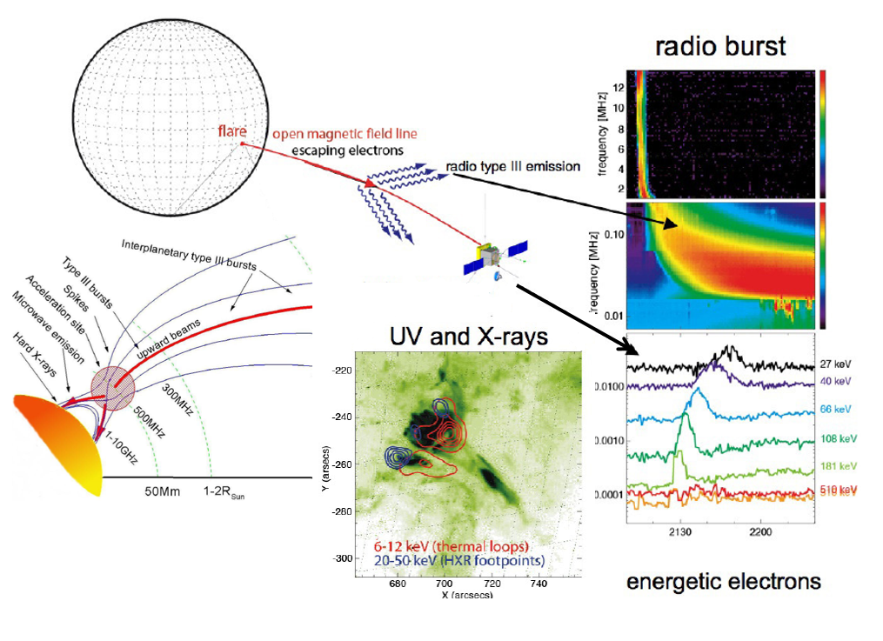

Slide 5
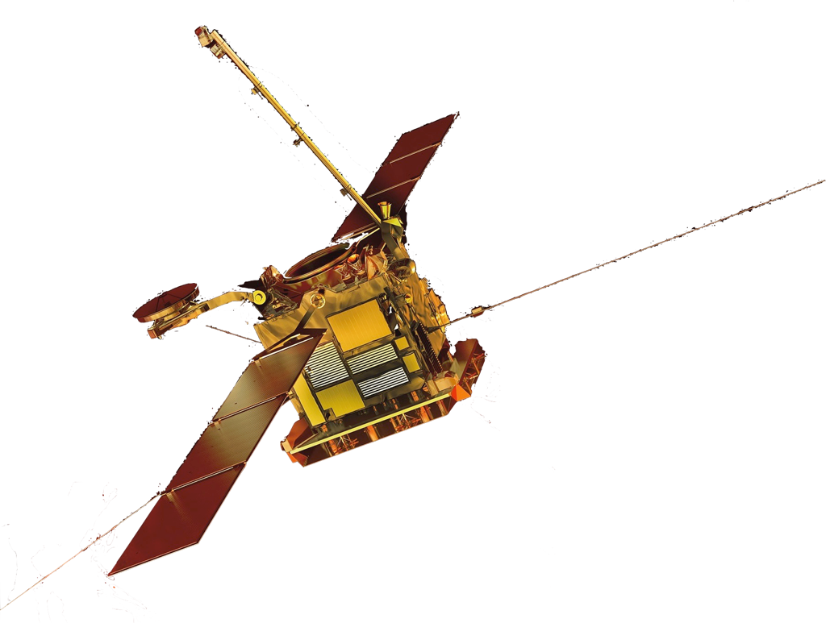
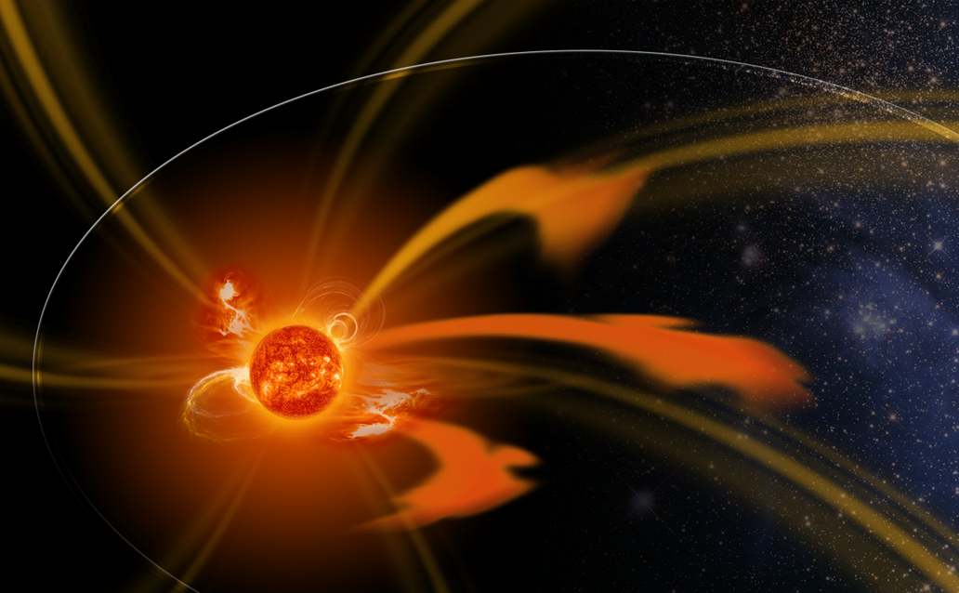
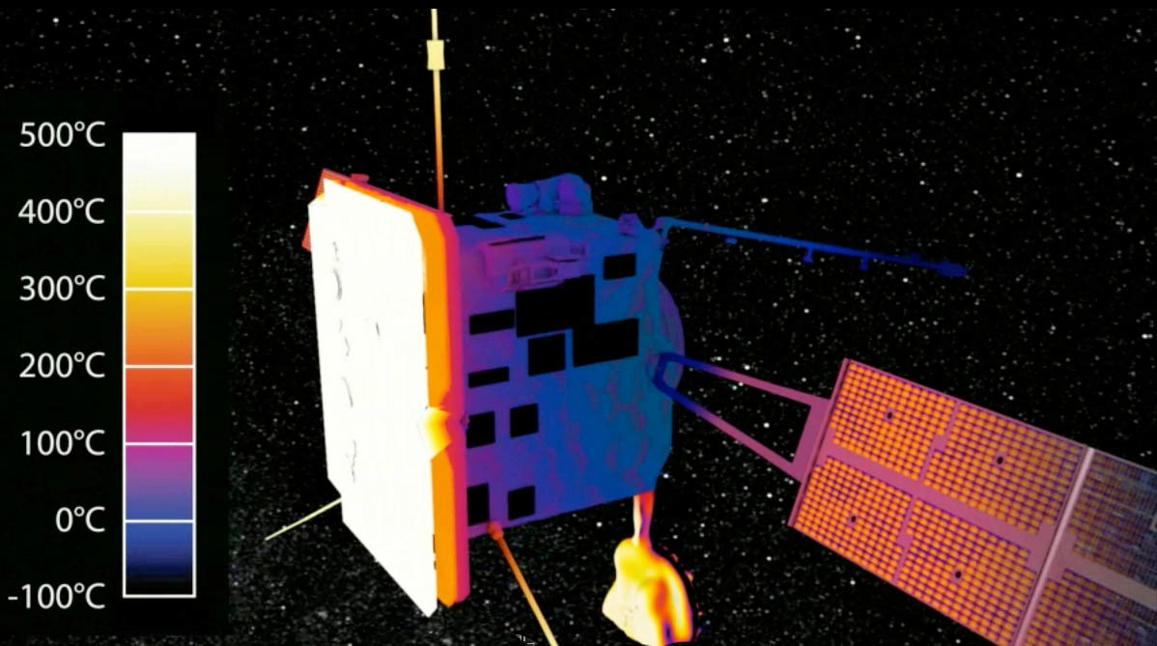
Solar Orbiter
Exploring the Sun-Heliosphere Connection
High-latitude Observations
The Spacecraft
Three-axis stabilized spacecraft, Sun pointing
Closest Sun encounter: 0.28 AU
Heat shield to protect spacecraft and payload
Perihelion Observations
High-latitude Observations

Slide 6
Solar Orbiter
Exploring the Sun-Heliosphere Connection
High-latitude Observations
The Spacecraft
Three-axis stabilized spacecraft, Sun pointing
Closest Sun encounter: 0.28 AU
Heat shield to protect spacecraft and payload
Overall mass: ~ 1800 kg Maximum power demand: ~ 1100W
Re-use of BepiColombo unit designs and technology
NASA-provided launch vehicle
Perihelion Observations
High-latitude Observations

Slide 7
Solar Orbiter
Exploring the Sun-Heliosphere Connection
High-latitude Observations
Mission Summary
Launch: July 2017 (Backup: Oct 2018)
Cruise Phase: 3 years
Nominal Mission: 3.5 years
Extended Mission: 2.5 years
Orbit: 0.28–0.91 AU (P=150-180 days)
Out-of-Ecliptic View: Multiple gravity assists with Venus to increase inclination out of the ecliptic to >24° (nominal mission), >34° (extended mission)
Reduced relative rotation: Observations of evolving structures on solar surface & in heliosphere for almost a complete solar rotation
Perihelion Observations
High-latitude Observations

Slide 8
Solar Orbiter
Exploring the Sun-Heliosphere Connection
Remote-sensing windows (10 days each)
High-latitude Observations
Mission Summary
Launch: July 2017 (Backup: Oct 2018)
Cruise Phase: 3 years
Nominal Mission: 3.5 years
Extended Mission: 2.5 years
Orbit: 0.28–0.91 AU (P=150-180 days)
Out-of-Ecliptic View: Multiple gravity assists with Venus to increase inclination out of the ecliptic to >24° (nominal mission), >34° (extended mission)
Reduced relative rotation: Observations of evolving structures on solar surface & in heliosphere for almost a complete solar rotation
High-latitude Observations
Perihelion Observations
Perihelion Observations
High-latitude Observations
High-latitude Observations

Slide 9
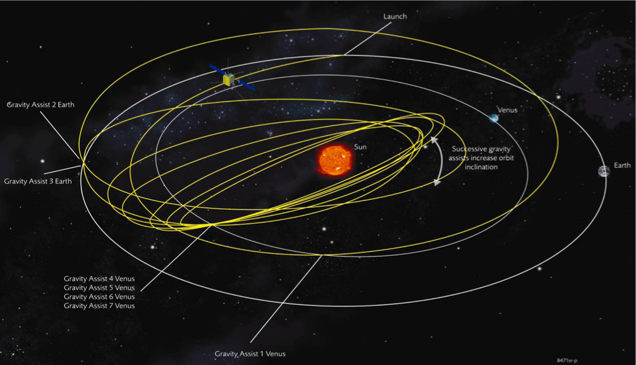
Mission Profile

Slide 10
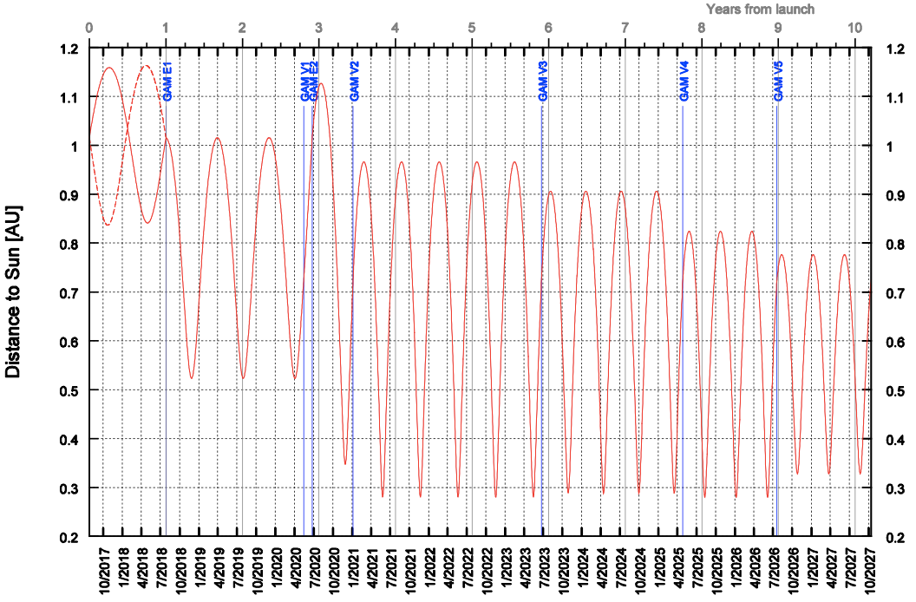
July 2017 Launch: Solar Distance

Slide 11
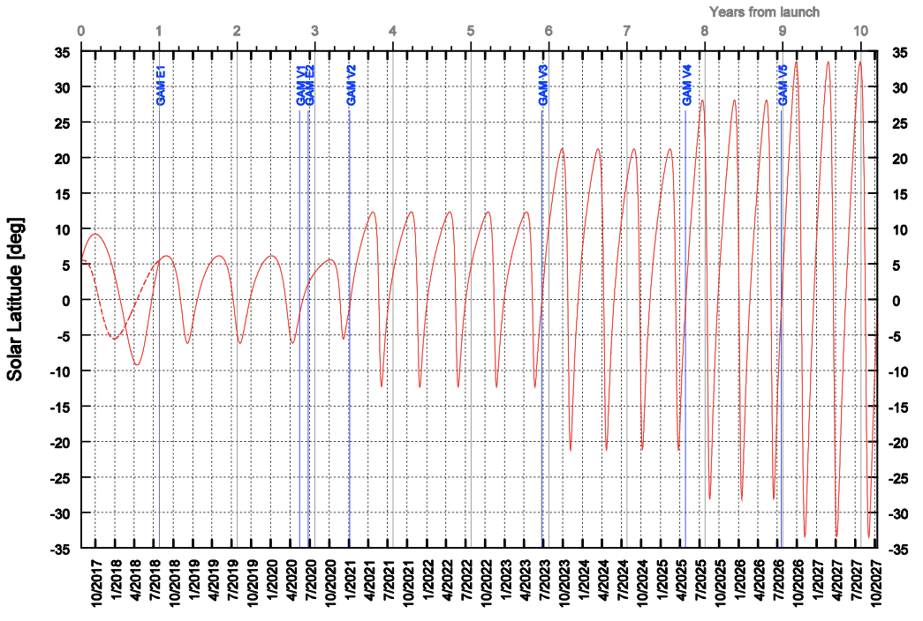
July 2017 Launch: Solar Latitude

Slide 12
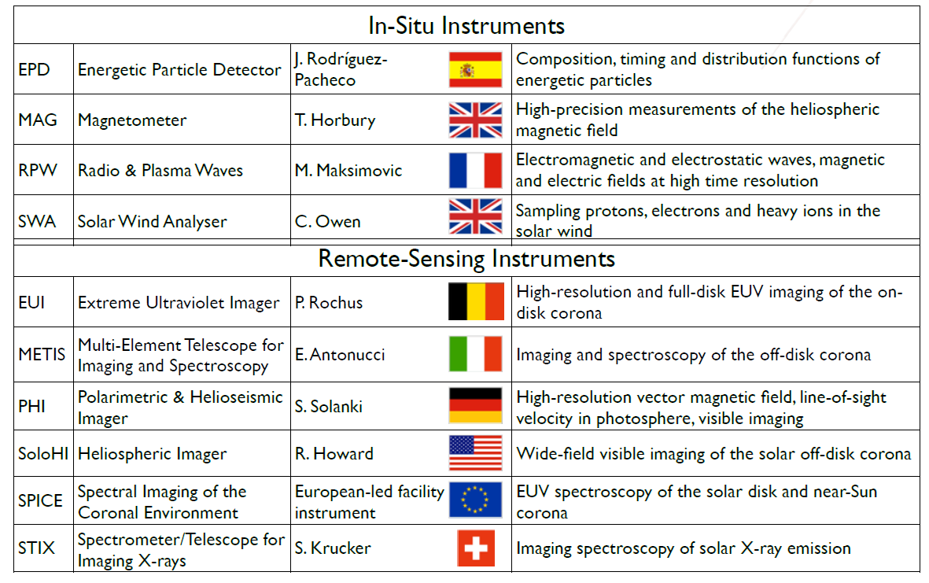
Payload

Slide 13
The Spacecraft
RPW Antennae
Heatshield with Aperture Doors
Instrument Boom
Tiltable Solar Arrays
High-Gain Antenna

Slide 14
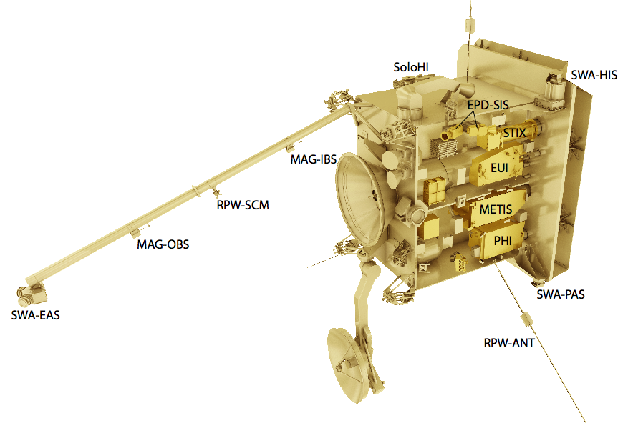
Payload Accommodation

Slide 15
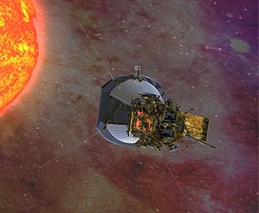
Synergies with Solar Probe Plus

Slide 17
Synergy between Solar Orbiter and other Observatories
Notes:
for comparison:
SOHO: 200 MB/day [=1.6 Gbit/day]
SO: 524 MB/day [666./((150+168))/2 = 4.19 Gbit/day] -> 3x SOHO
SDO: 1.4 TB/day [=11232 Gbit/day] -> 2672x Solar Orbiter
- In 85 minutes, SDO [at 130 Mb/s] has downlinked all data Solar Orbiter will be able to send down in one orbit!

Slide 19
Solar Orbiter
Exploring the Sun-Heliosphere Connection
High-latitude Observations
Perihelion Observations
www.solarorbiter.org
High-latitude Observations
Courtesy W. Thompson
Notes:
Solar Orbiter will address the central question of heliophysics: How does the Sun create and control the heliosphere?
Solar Orbiter will make
- in-situ measurements of the solar wind plasma, fields, waves, and energetic particles as close as 0.28 AU from the Sun
- simultaneously with high-resolution imaging and spectroscopic observations of the Sun in and out of the ecliptic plane.
The combination of in-situ and remote sensing instruments on the same spacecraft, together with the new, inner-heliospheric perspective, distinguishes Solar Orbiter from all previous and current missions, enabling breakthrough science which can be achieved in no other way.
Solar Orbiter also has important synergies with NASA’s Solar Probe Plus mission. Coordinated observations with this mission, combined with data from other missions operating in the inner heliosphere (or providing remote-sensing observations of the near-Sun environment), will contribute greatly to our understanding of the Sun and its environment.

Slide 20
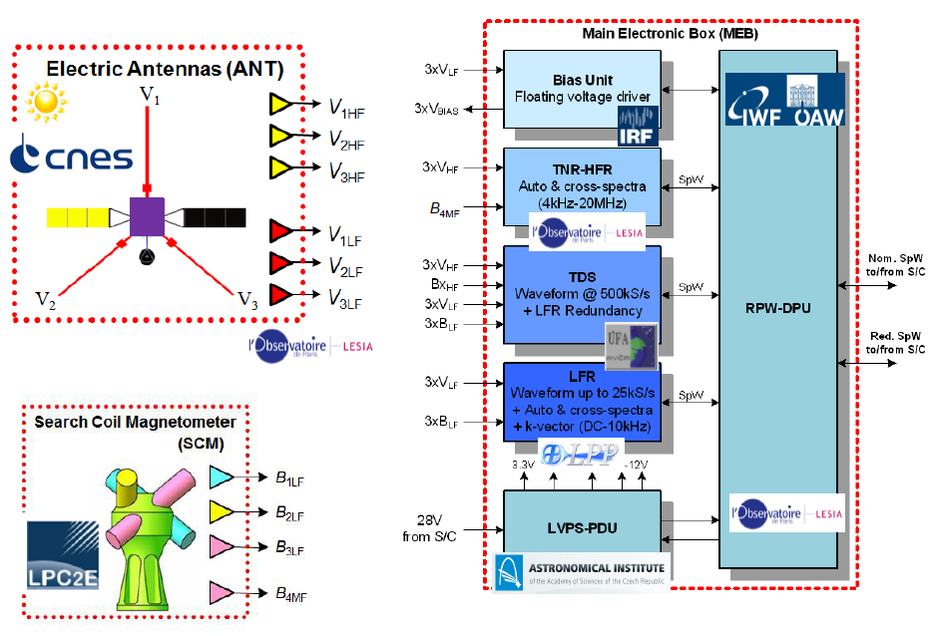

Slide 21
